Slide 1
A Novel Polymer-Metal Bone Substitute with Antibacterial and Osseointegration Capabilities
Catherine Trojanowski
April 12, 2021

Slide 2
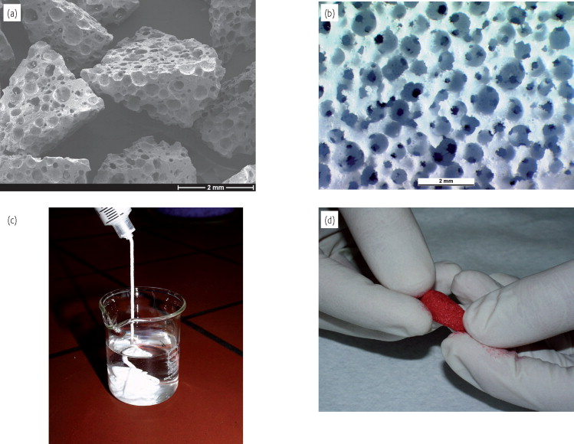
Identification and Significance of the Problem
More than 2 million bone grafting procedures are performed worldwide every year²
Bone substitutes are:
synthetic or biologically derived products which can be inserted for the treatment of a bone defect^{2,3}
increasingly being used in various surgical fields²
Many current bone substitutes lack mechanical strength and are incapable of inhibiting bacterial colonization^{3,4}
¹

Slide 3
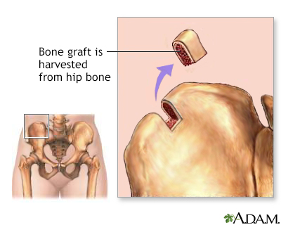
Overall Background
Bone grafts promote bone healing and growth and restore bone defects^{3,5}
Bone grafting can be done using:
Autografts
Allografts
Xenografts
Bone substitutes³
Due to limitations of current bone substitutes, novel alternatives are required
⁶

Slide 4
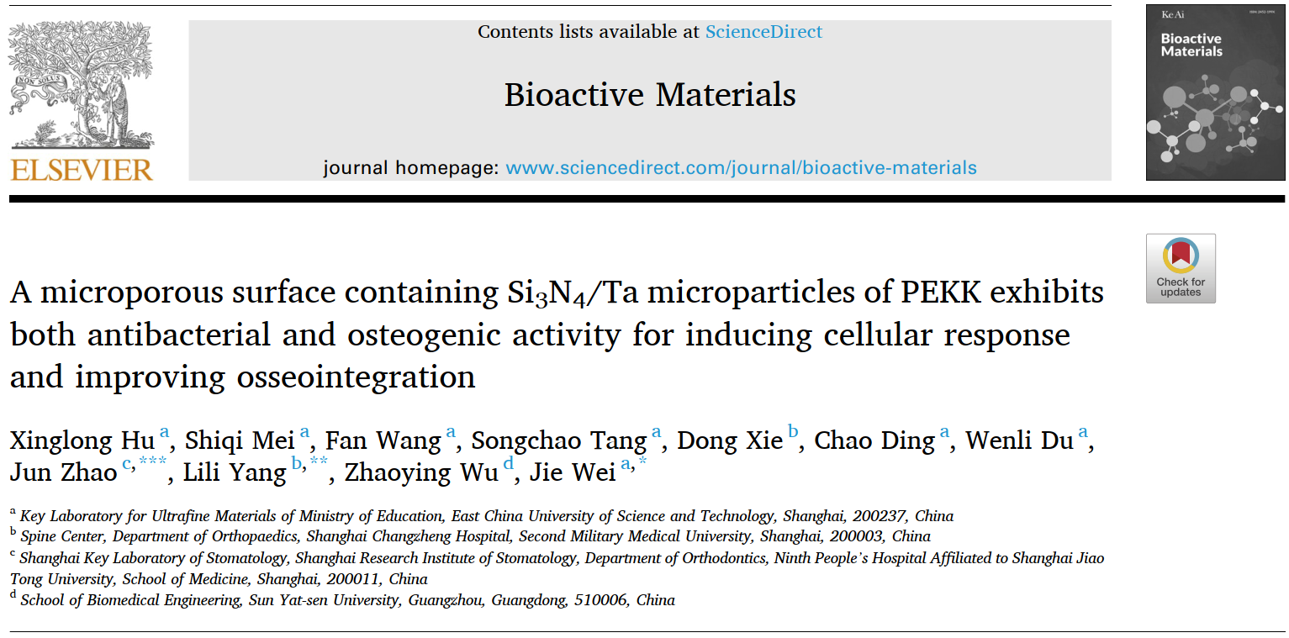
Related Research
⁷

Slide 5
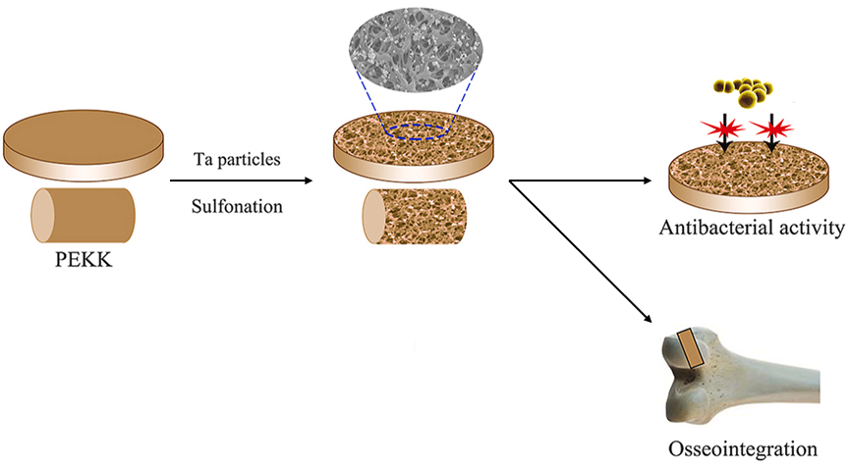
Technical Approach
Staphylococcus aureus (S. aureus)
eADF4(C16) coating
^{7 (modified)}

Slide 6
Anticipated Results and Commercial Applications of Research
Osseointegration Capability
Adequate Strength
Antibacterial Activity
Anticipated that the PEKK/tantalum/eADF4(C16) bone substitute will:
achieve successful osseointegration
possess sufficient strength
maintain antibacterial activity for an adequate timeframe
Commercial viability is expected due to:
expanding market potential of bone substitutes
anticipated superiority of the proposed solution

Slide 7
Objectives and Research Plan
Specific Aim 1: Prepare the polymer-metal composite made from PEKK, tantalum, and eADF4(C16)
Sulfonation⁷
Dip coating⁸
Specific Aim 2: Test the antibacterial and mechanical properties of the polymer-metal composite in vitro
Bacterial counting assay⁷
Examination using scanning electron microscopy⁸
Mechanical tests
Specific Aim 3: Test the osseointegration capabilities of the polymer-metal composite using a rabbit model
Preparation of histological tissue sections⁷
Push-out tests⁷
Task | Duration
Specific Aim 1 | 4 months
Specific Aim 2 | 8 months
Specific Aim 3 | 6 months

Slide 8
Description of Company
PI assisted by 1 postdoctoral associate, 2 laboratory technicians, and 2 graduate students working in the Applied Biomaterials Laboratory at North Point University
No subcontracts
Consultants:
Dr. Amber Beaumont from the Industrial Design Laboratory
Dr. Robert Kingsley from the Advanced Material Laboratory
Dr. Barbara Wilkinson from the School of Veterinary Studies will conduct all required animal surgeries

Slide 9
Budget
Expense | Cost
Direct Costs | $865,000
Senior Personnel | $483,000
Other Personnel | $232,000
Participant Support | $86,000
Materials & Supplies | $60,000
Publication & Documentation | $4000
Indirect Costs | $1,787,500
Total Budget | $2,652,500

Slide 10
References
M. Bohner, “Resorbable biomaterials as bone graft substitutes,” Mater. Today, vol. 13, no. 1, pp. 24–30, Feb. 2010, doi: 10.1016/S1369-7021(10)70014-6.
V. Campana et al., “Bone substitutes in orthopaedic surgery: from basic science to clinical practice,” J. Mater. Sci. Mater. Med., vol. 25, pp. 2445–2461, May 2014, doi: 10.1007/s10856-014-5240-2.
G. Fernandez de Grado et al., “Bone substitutes: a review of their characteristics, clinical use, and perspectives for large bone defects management,” J. Tissue Eng., vol. 9, Jun. 2018, doi: 10.1177/2041731418776819.
C. C. Coelho, R. Araújo, P. A. Quadros, S. R. Sousa, and F. J. Monteiro, “Antibacterial bone substitute of hydroxyapatite and magnesium oxide to prevent dental and orthopaedic infections,” Mater. Sci. Eng. C, vol. 97, pp. 529–538, Apr. 2019, doi: 10.1016/J.MSEC.2018.12.059.
“Bone Grafting | Johns Hopkins Medicine.” https://www.hopkinsmedicine.org/health/treatment-tests-and-therapies/bone-grafting (accessed Jul. 17, 2021).
“Bone Graft Harvest.” https://medlineplus.gov/ency/imagepages/8745.htm (accessed Aug. 7, 2021).
X. Hu et al., “A microporous surface containing Si3N4/Ta microparticles of PEKK exhibits both antibacterial and osteogenic activity for inducing cellular response and improving osseointegration,” Bioact. Mater., vol. 6, no. 10, pp. 3136–3149, Oct. 2021, doi: 10.1016/j.bioactmat.2021.02.027.
C. Sommer, H. Bargel, N. Raßmann, and T. Scheibel, “Microbial repellence properties of engineered spider silk coatings prevent biofilm formation of opportunistic bacterial strains,” MRS Commun., Apr. 2021, doi: 10.1557/s43579-021-00034-y.

